Slide 1
Zero Lecture on
Design and Analysis of Algorithm
CSE408

Slide 2
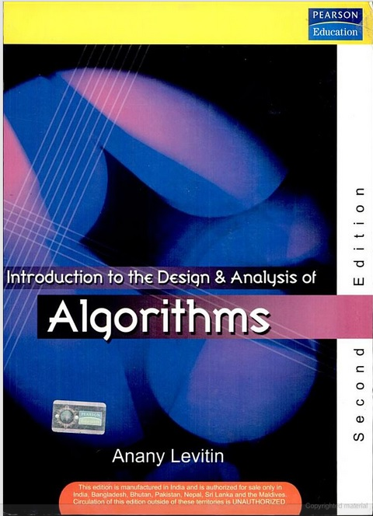
Course Details
LTP – 3 0 0 [Three lectures/week]
Text Book
  INTRODUCTION TO THE DESIGN
  AND ANALYSIS OF ALGORITHMS
    ANANY LEVITIN,
    PEARSON EDUCATION

Slide 3
Detail of Academic Tasks
AT1: Test1 Lecture #11(Before MTE)
AT2: Test2 Lecture #19(Before MTE)
AT3: Test3 Lecture #33(After MTE)
Best 2 will be considered with the conditions as :
AT1 or AT2
AT3 will be mandatory

Slide 4
Weight age of AT,MTT,ETT
Attendance: 5 Marks
Academic Tasks(CA): 25 Marks
MTT : 20 Marks
ETT: 50 Marks
1-<number>

Slide 5
Need to study this course .

Slide 6
Why are we learning Design and analysis of algorithms?
Algorithms are used in almost every program or software system.
Once we design an algorithm we need to know how well it performs on any input.
In particular we would like to know whether there are better algorithms for the problem, An answer to this first demands a way to analyze an algorithm in a machine-independent way.
Some Specific design techniques are essential ingredients of many software applications.

Slide 7
The course contents CSE408
UNIT I - Foundations of algorithm
UNIT II - String matching algorithms and computational geometry
UNIT III - Divide and conquer and ordered statists
UNIT IV - Dynamic programming and greedy techniques
UNIT V - Backtracking and approximation algorithms
UNIT VI - Number-theoretic algorithms and complexity classes

Slide 8
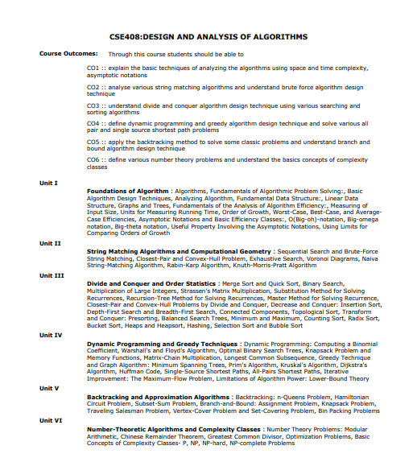
1-<number>

Slide 9
Course Outcomes
CO1 ::Explain the basic techniques of analyzing the algorithms using space and time complexity, asymptotic notations
CO2 ::Analyze various string matching algorithms and understand brute force algorithm design technique
CO3 :: Understand divide and conquer algorithm design technique using various searching and sorting algorithms
1-<number>

Slide 10
..contd..
CO4 :: define dynamic programming and greedy algorithm design technique and solve various all pair and single source shortest path problems
CO5 :: apply the backtracking method to solve some classic problems and understand branch and bound algorithm design technique
CO6 :: define various number theory problems and understand the basics concepts of complexity classes
1-<number>

Slide 11
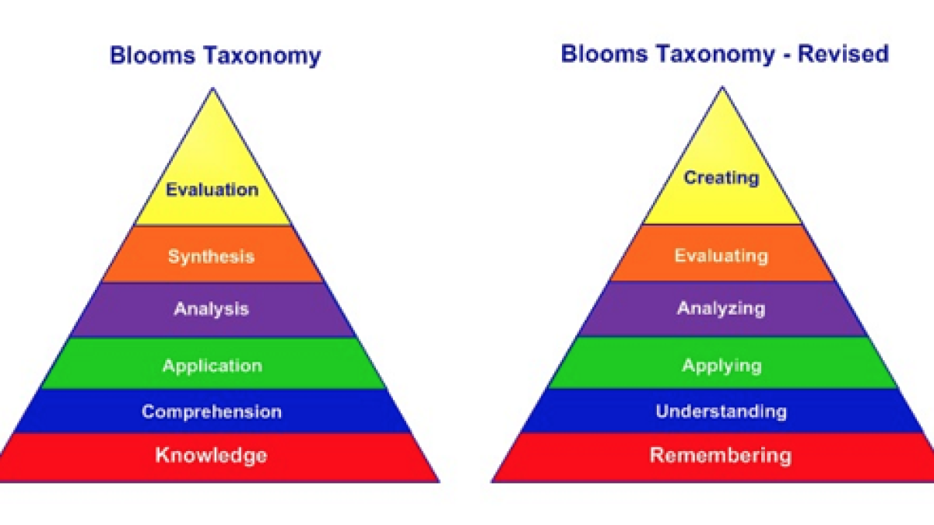
RBT– Revised Blooms Tax anomy
1-<number>

Slide 12
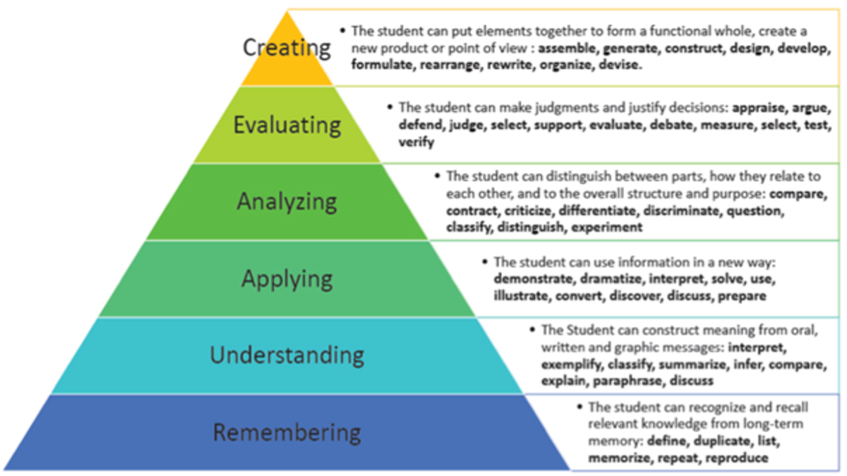
1-<number>

Slide 13
MOOC-Massive Open Online Course
Approved (MOOC Course)
NPTEL
https://nptel.ac.in/courses/106106131 /
Benefit to register the Approved MOOC is All CAs
1-<number>

Slide 14
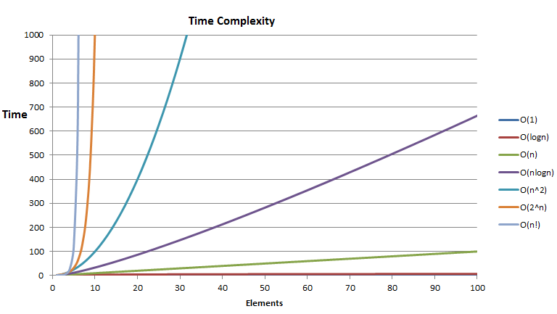

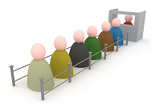
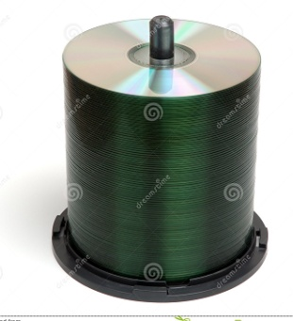
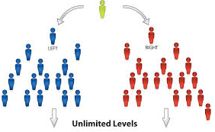
Foundations of algorithm
UNIT I
Basic DS
Notes:
Analysis and growth

Slide 15

String matching algorithms and computational geometry
UNIT II

Slide 16

Divide and conquer and ordered statists
UNIT III

Slide 17


Dynamic programming and greedy technique
UNIT IV
Dynamic programming(Knap sack)
Greedy technique
Notes:
Dynamic programming(Knap sack)

Slide 18

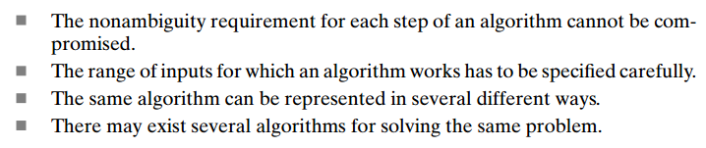
Algorithm

Slide 19
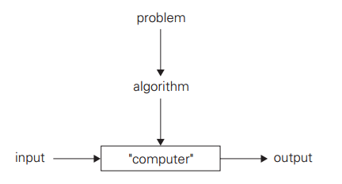

Slide 20
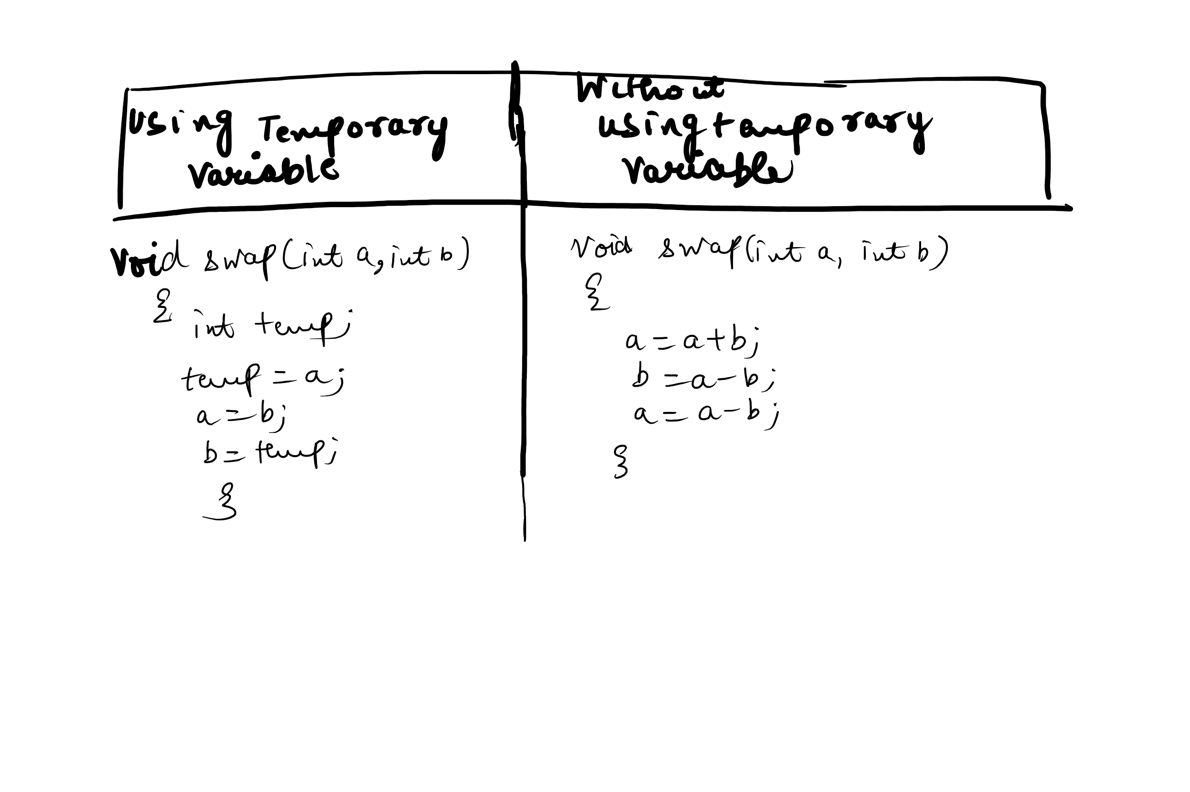
Problem for Swapping 2 Numbers

Slide 21
Fundamentals of algorithmic problem solving
Understanding the problem
Ascertaining the capabilities of a computational device.
Choosing between exact and approximate problem solving.
Deciding an appropriate Data Structure
Algorithm design techniques.
Methods of specifying an algorithm.
Proving an algorithms correctness
Analyzing an algorithm.
Coding an algorithm

Slide 22
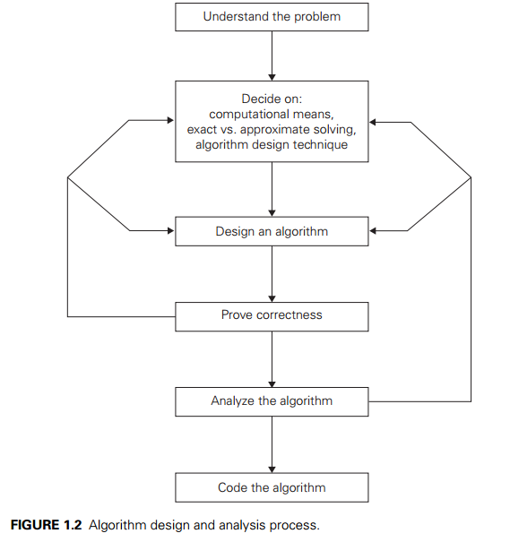

Slide 23
Step 1- Understanding the problem
Understand the given problem completely.
Read the problem description carefully
Ask doubts about the problem
Do few examples
Think about special cases like boundary value
Know about the already known algorithms for solving that problem
Clear about the input to an algorithm.

Slide 24
Step 2- Ascertaining the Capabilities of a computational device
Sequential Algorithms: Instructions are executed one after another and one operation at a time. Algorithms designed to be executed on such machine are called sequential algorithms
Parallel Algorithms: Modern computers that can execute instructions in parallel. Algorithms designed to be executed on such machine are called parallel algorithms

Slide 25
Step 3- Choosing between exact and approximate problem solving
Exact Algorithm: Solving problem exactly
Approx. Algm. : Solving problem approximately
Why Approx. Algm.?
Some problems cannot be solved exactly
Solving problem exactly can be unacceptably slow because of the problem complexity.

Slide 26
Step 4- Deciding on appropriate Data Structures
Decide on the suitable data structure
A Data structure is defined as a particular scheme of organizing related data items.

Slide 27
Step 5- Algorithm Design techniques
An algorithm design technique is a general approach to solve problems algorithmically.
The various design techniques are:
Brute force
Divide and conquer
Greedy approach
Dynamic programming
Backtracking

Slide 28
Step 6- Method of specifying an algorithm
Natural language
There are 3 methods:
  Easy but ambiguous
Pseudo code
  Mixture of programming language and natural language
Flow chart
  It is pictorial representation of the algorithm.
  Here symbols are used.

Slide 29
Step 7- Proving an algorithm’s correctness
Correctness: Prove that the algo. Yields the required result for every legitimate input in a finite amount of time.
A common technique for proving correctness is to use mathematical induction
In order to show the alg. Is incorrect, we have to take just one instance of its input for which the algm. Fails.
If a algo. is found to be incorrect, then reconsider one or more those decisions
For approx. algo. We should show that the error produced by the algo does not exceed the predefined limit.

Slide 30
Step 8- Analyzing an algorithm
Analyze the following qualities of the algorithm
Efficiency:
  Time efficiency and Space efficiency
Simplicity
  Simple algorithms mean easy to understand and easy to program.
Generality
  Design an algm. for a problem in more general terms. In some cases, designing more general algm. Is unnecessary or difficult.
  Optimality
    The algorithm should produce optimal results.

Slide 31
Step 9- Coding an algorithm
Algorithms are designed to be implemented as computer programs.
Use code tuning technique. For eg., replacing costlier multiplication operation with cheaper addition operation.

Slide 32
Fundamental data structures
graph
tree and binary tree
set and dictionary
list
  array
  linked list
  string
stack
queue
priority queue/heap
1-<number>

Slide 33
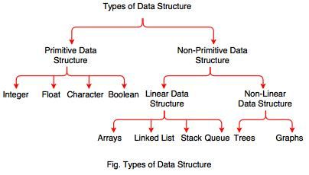
TYPES OF DATA STRUCTURES

Slide 34
Linear Data Structures
Arrays
  A sequence of n items of the same data type that are stored contiguously in computer memory and made accessible by specifying a value of the array’s index.
Linked List
  A sequence of zero or more nodes each containing two kinds of information: some data and one or more links called pointers to other nodes of the linked list.
  Singly linked list (next pointer)
  Doubly linked list (next + previous pointers)
Arrays
  fixed length (need preliminary reservation of memory)
  contiguous memory locations
  direct access
  Insert/delete
Linked Lists
  dynamic length
  arbitrary memory locations
  access by following links
  Insert/delete
…
.
a1
a2
an
1-<number>

Slide 35
Stacks and Queues
Stacks
  A stack of plates
    insertion/deletion can be done only at the top.
    LIFO
  Two operations (push and pop)
Queues
  A queue of customers waiting for services
    Insertion/enqueue from the rear and deletion/dequeue from the front.
    FIFO
  Two operations (enqueue and dequeue)
1-<number>

Slide 36
Priority Queue and Heap
Priority queues (implemented using heaps)
  A data structure for maintaining a set of elements, each associated with a key/priority, with the following operations
    Finding the element with the highest priority
    Deleting the element with the highest priority
    Inserting a new element
  Scheduling jobs on a shared computer
9
6
8
5
2
3
9
6
8
5
2
3
1-<number>

Slide 37
Graphs
Formal definition
  A graph G = <V, E> is defined by a pair of two sets: a finite set V of items called vertices and a set E of vertex pairs called edges.
Undirected and directed graphs (digraphs).
maximum number of edges in an undirected graph with |V| vertices
Complete graphs
  A graph with every pair of its vertices connected by an edge is called complete, K_{|V|}
1-<number>

Slide 38
Graph Representation
Adjacency matrix
  n x n boolean matrix if |V| is n.
  The element on the ith row and jth column is 1 if there’s an edge from ith vertex to the jth vertex; otherwise 0.
  The adjacency matrix of an undirected graph is symmetric.
Adjacency linked lists
  A collection of linked lists, one for each vertex, that contain all the vertices adjacent to the list’s vertex.
Which data structure would you use if the graph is a 100-node star shape?
0 1 1 1
0 0 0 1
0 0 0 1
0 0 0 0
2
3
4
4
4
1-<number>

Slide 39
Weighted Graphs
Weighted graphs
  Graphs or digraphs with numbers assigned to the edges.
- A dense graph is a graph in which the number of edges is close to the maximal number of edges. The opposite, a graph with only a few edges, is a sparse graph.
3
1
2
6
5
7
3
4
9
8
1-<number>

Slide 40
Graph Properties -- Paths and Connectivity
Paths
  A path from vertex u to v of a graph G is defined as a sequence of adjacent (connected by an edge) vertices that starts with u and ends with v.
  Simple paths: All edges of a path are distinct.
  Path lengths: the number of edges, or the number of vertices – 1.
Connected graphs
  A graph is said to be connected if for every pair of its vertices u and v there is a path from u to v.
Connected component
  The maximum connected subgraph of a given graph.
1-<number>
Notes:
Examples of a simple path and a not simple path.
Connected graphs: starting from any vertex, we can always find a path to reach all the other vertices. (Ball-String example.)
From NIST:
Connected graphs:
Definition: An undirected graph that has a path between every pair of vertices.
Strongly connected graphs:
Definition: A directed graph that has a path from each vertex to every other vertex.
Connected component: …
Strongly connected component:
a strongly connected component of a digraph G is a maximal strongly connected subgraph of G.

Slide 41
Graph Properties -- Acyclicity
Cycle
  A simple path of a positive length that starts and ends a the same vertex.
Acyclic graph
  A graph without cycles
  DAG (Directed Acyclic Graph)
1
2
3
4
1-<number>

Slide 42
Trees
Trees
  A tree (or free tree) is a connected acyclic graph.
  Forest: a graph that has no cycles but is not necessarily connected.
Properties of trees
  - For every two vertices in a tree there always exists exactly one simple path from one of these vertices to the other.
    Rooted trees: The above property makes it possible to select an arbitrary vertex in a free tree and consider it as the root of the so called rooted tree.
    Levels in a rooted tree.
1
3
5
3
4
1
5
2
4
  |E| = |V| - 1
2
1-<number>

Slide 43
Rooted Trees (I)
Ancestors
  For any vertex v in a tree T, all the vertices on the simple path from the root to that vertex are called ancestors.
Descendants
  All the vertices for which a vertex v is an ancestor are said to be descendants of v.
Parent, child and siblings
  If (u, v) is the last edge of the simple path from the root to vertex v, u is said to be the parent of v and v is called a child of u.
  Vertices that have the same parent are called siblings.
Leaves
  A vertex without children is called a leaf.
Subtree
  A vertex v with all its descendants is called the subtree of T rooted at v.
1-<number>

Slide 44
Rooted Trees (II)
Depth of a vertex
  The length of the simple path from the root to the vertex.
Height of a tree
  The length of the longest simple path from the root to a leaf.
h = 2
3
4
1
5
2
1-<number>

Slide 45
Ordered Trees
Ordered trees
  An ordered tree is a rooted tree in which all the children of each vertex are ordered.
Binary trees
  A binary tree is an ordered tree in which every vertex has no more than two children and each children is designated s either a left child or a right child of its parent.
Binary search trees
  Each vertex is assigned a number.
  A number assigned to each parental vertex is larger than all the numbers in its left subtree and smaller than all the numbers in its right subtree.
⎣log₂n⎦ ≤ h ≤ n – 1, where h is the height of a binary tree and n the size.
9
6
6
8
3
9
5
2
3
2
5
8
1-<number>

